Slide 1
HEART ATTACK RISK PREDICTION USING AUTO ML
TEAM DETAILS
P.JAYANTH GANESH (21EG505808)
D.DEEPAK NAYAK (21EG505813)
L.PRANEETH VARMA (21EG505844)
PROJECT SUPERVISIOR
RAGHAVENDRA KULKARNI
ASSISTANT PROFESSOR

Slide 2
INTRODUCTION
Heart disease is a significant global health concern, and early detection of individuals at risk of a heart attack is crucial for preventing life-threatening events. To address this, we have embarked on a project utilizing AutoML (Automated Machine Learning) to predict the risk of heart attacks. AutoML is a powerful approach that automates the process of model selection, making it accessible to both experts and non-experts in machine learning.
Our project aims to leverage the capabilities of AutoML to create an accurate and reliable predictive model for heart attack risk assessment. By analyzing a comprehensive dataset comprising various health-related features such as age, gender, cholesterol levels, blood pressure, and lifestyle factors, we aim to develop a model that can identify individuals who may be at a higher risk of experiencing a heart attack.

Slide 3
PROBLEM STATEMENT
Develop a machine learning model using AutoML to accurately predict the risk of heart attacks based on various factors such as age, gender, cholesterol levels, blood pressure, and other relevant medical data.
The goal is to create a reliable and efficient system that can assist healthcare professionals in identifying individuals at high risk of heart attacks, enabling timely interventions and potentially saving lives.

Slide 4
PROPOSED METH0D
1.DATA ANALYSIS : This step involves exploring and understanding the dataset. You'll examine the data's structure, summary statistics, and relationships between variables. Data analysis helps you identify patterns, outliers, and potential issues that may require preprocessing.
2.FEATURE ENGINEERING : Feature engineering involves creating new features or transforming existing ones to make them more informative for the model. In the context of heart attack risk prediction, you might derive features like body mass index (BMI) from height and weight or create age groups for analysis.
3.STANDARDIZATION : Standardization typically refers to scaling numerical features to have a mean of 0 and a standard deviation of 1 (z-score normalization). This step ensures that all features have a similar scale and prevents some variables from dominating others during modeling.

Slide 5
PROPOSED METHOD
MODEL BUILDING:This is where AutoML comes into play. AutoML tools will automatically select suitable machine learning algorithms, preprocessors, and optimize hyperparameters to build the best-performing model. You can guide AutoML to focus on predicting heart attack risk.
PREDICTION:After training the model using AutoML, you can use it to make predictions. Users can input their data (e.g., age, cholesterol levels, blood pressure) into the system, and the model will provide a risk assessment for a potential heart attack.

Slide 6
EXPERIMENT ENVIRONMENT
OPERATING SYSTEM : WINDOWS
IDE : GOOGLE COLAB
LIBRARIES : PANDAS, NUMPY, SEABORN, MATPLOTLIB
PANDAS : Pandas is a powerful Python library for data manipulation and analysis. It provides data structures like DataFrames and Series, making it easy to work with structured data. Pandas is widely used for tasks such as data cleaning, transformation, and exploration in data science and analysis projects.
NUMPY : NumPy is a fundamental library for numerical computing in Python. It offers support for large, multi-dimensional arrays and matrices, along with a collection of mathematical functions. NumPy is the backbone of many scientific and data analysis libraries in Python, enabling efficient data manipulation and mathematical operations.

Slide 7
EXPERIMENT ENVIRONMENT
SEABORN : Seaborn is a data visualization library built on top of Matplotlib. It provides a high-level interface for creating aesthetically pleasing statistical graphics. Seaborn simplifies the creation of complex visualizations like scatter plots, heatmaps, and distribution plots, making it a popular choice for data visualization in Python.
MATPLOT : Matplotlib is a versatile and widely-used library for creating static, animated, or interactive visualizations in Python. It offers fine-grained control over plot customization and is the foundation for many other plotting libraries.
EVALML : EVALML is an open-source autoML library written in python that automates a large part of the machine learning process and we can easily evaluate which machine learning pipeline works for the given set of data.
PROGRAMMING LANGUAGE : PYTHON
HARDWARE REQURIEMENTS
PROCESSOR : INTEL I3
RAM : 8GB
SYSTEM TYPE : 64-BIT OPERATING SYSTEM

Slide 8
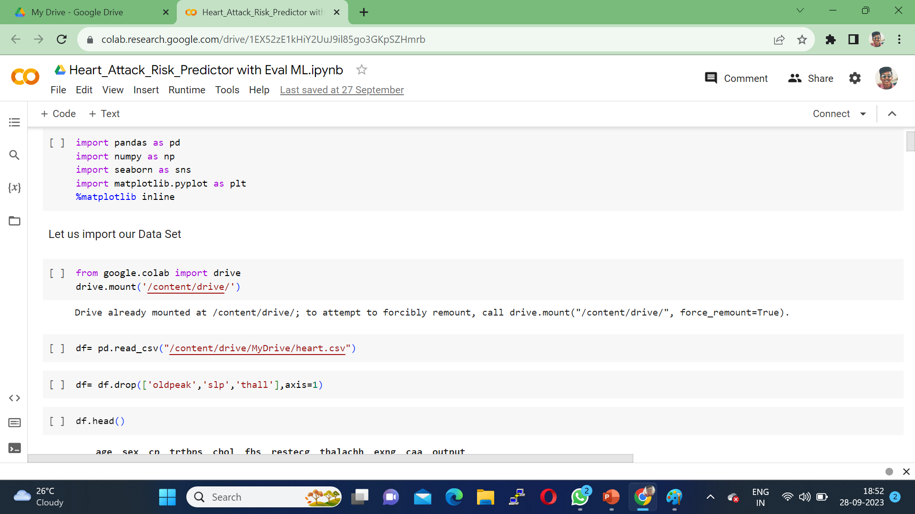
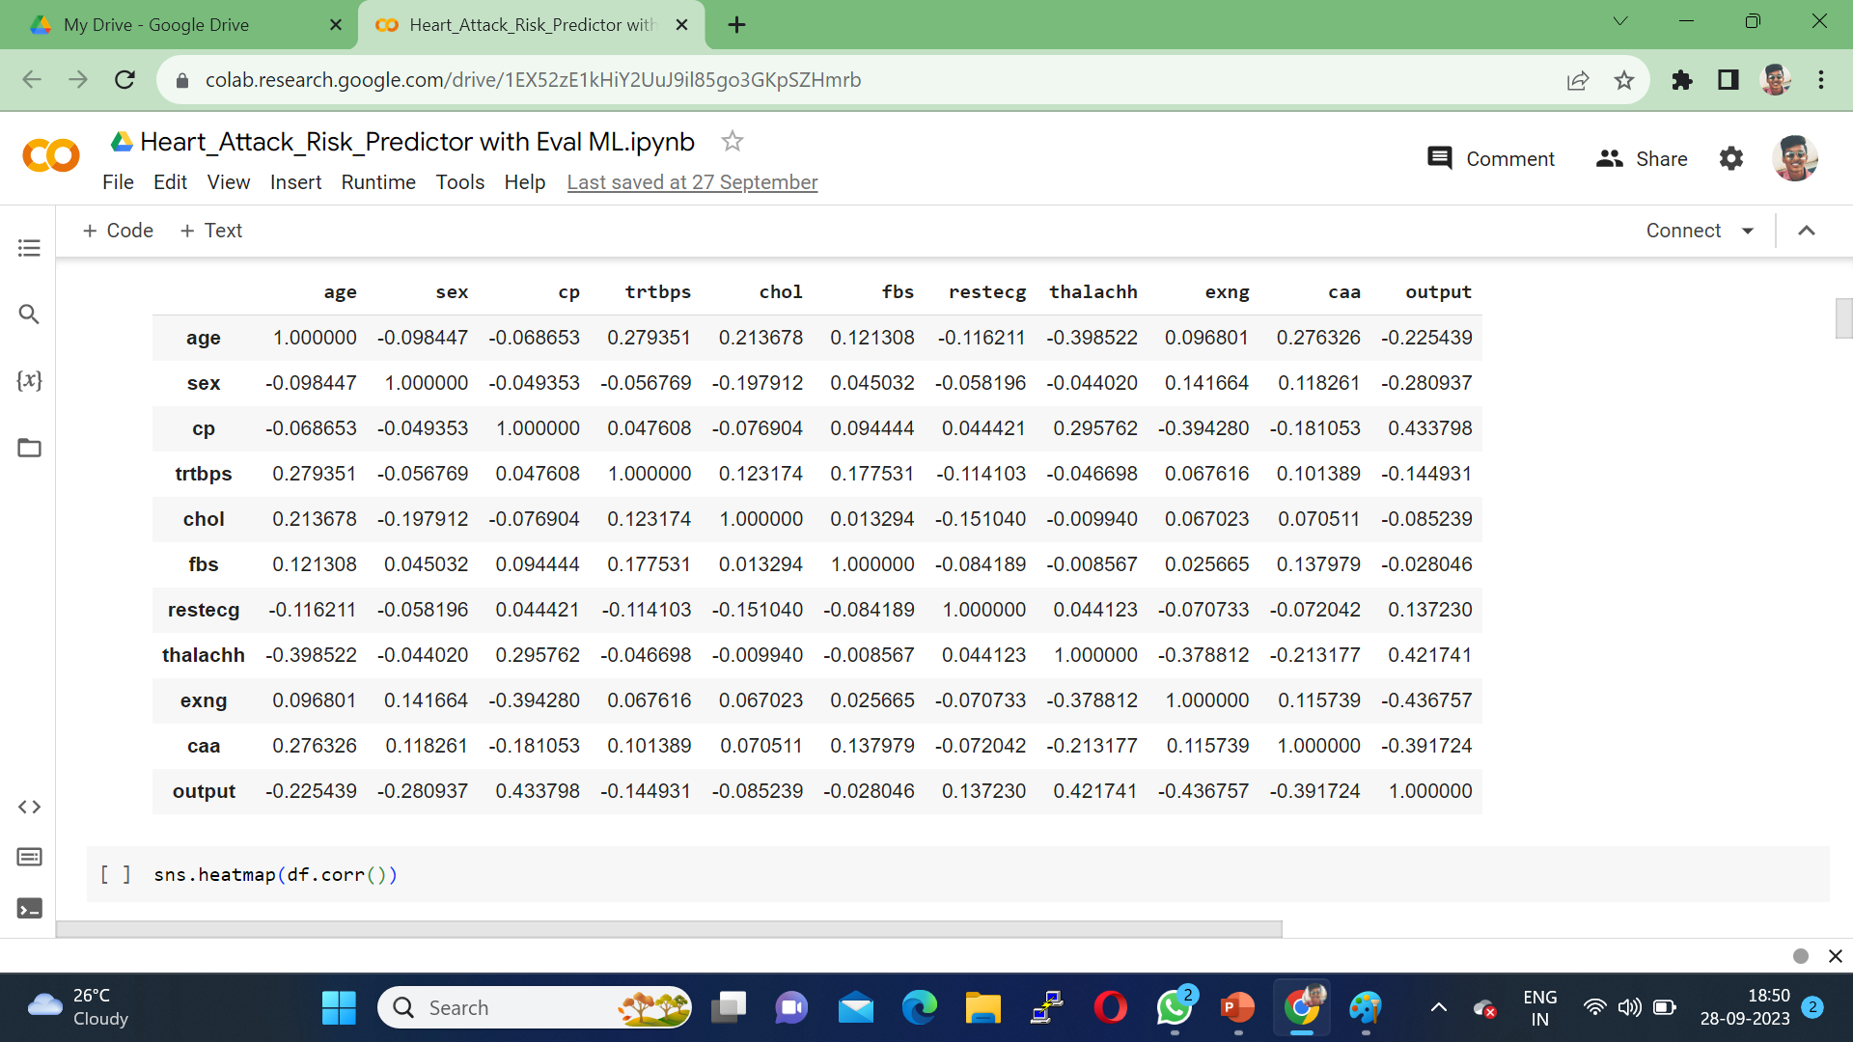
EXPERIMENT SCREENSHORTS

Slide 9
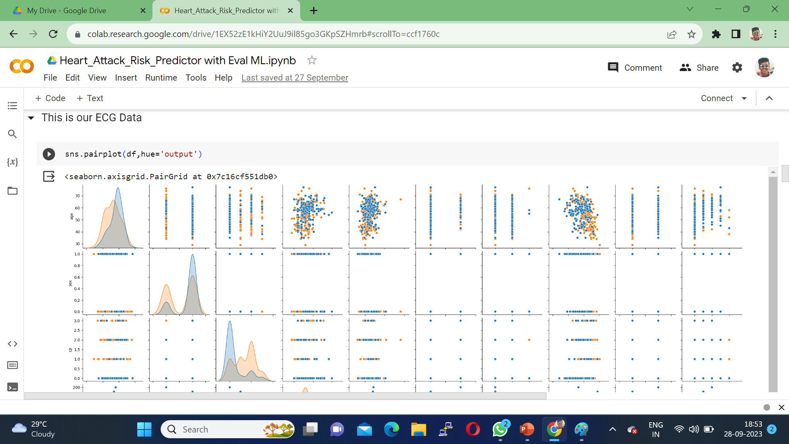
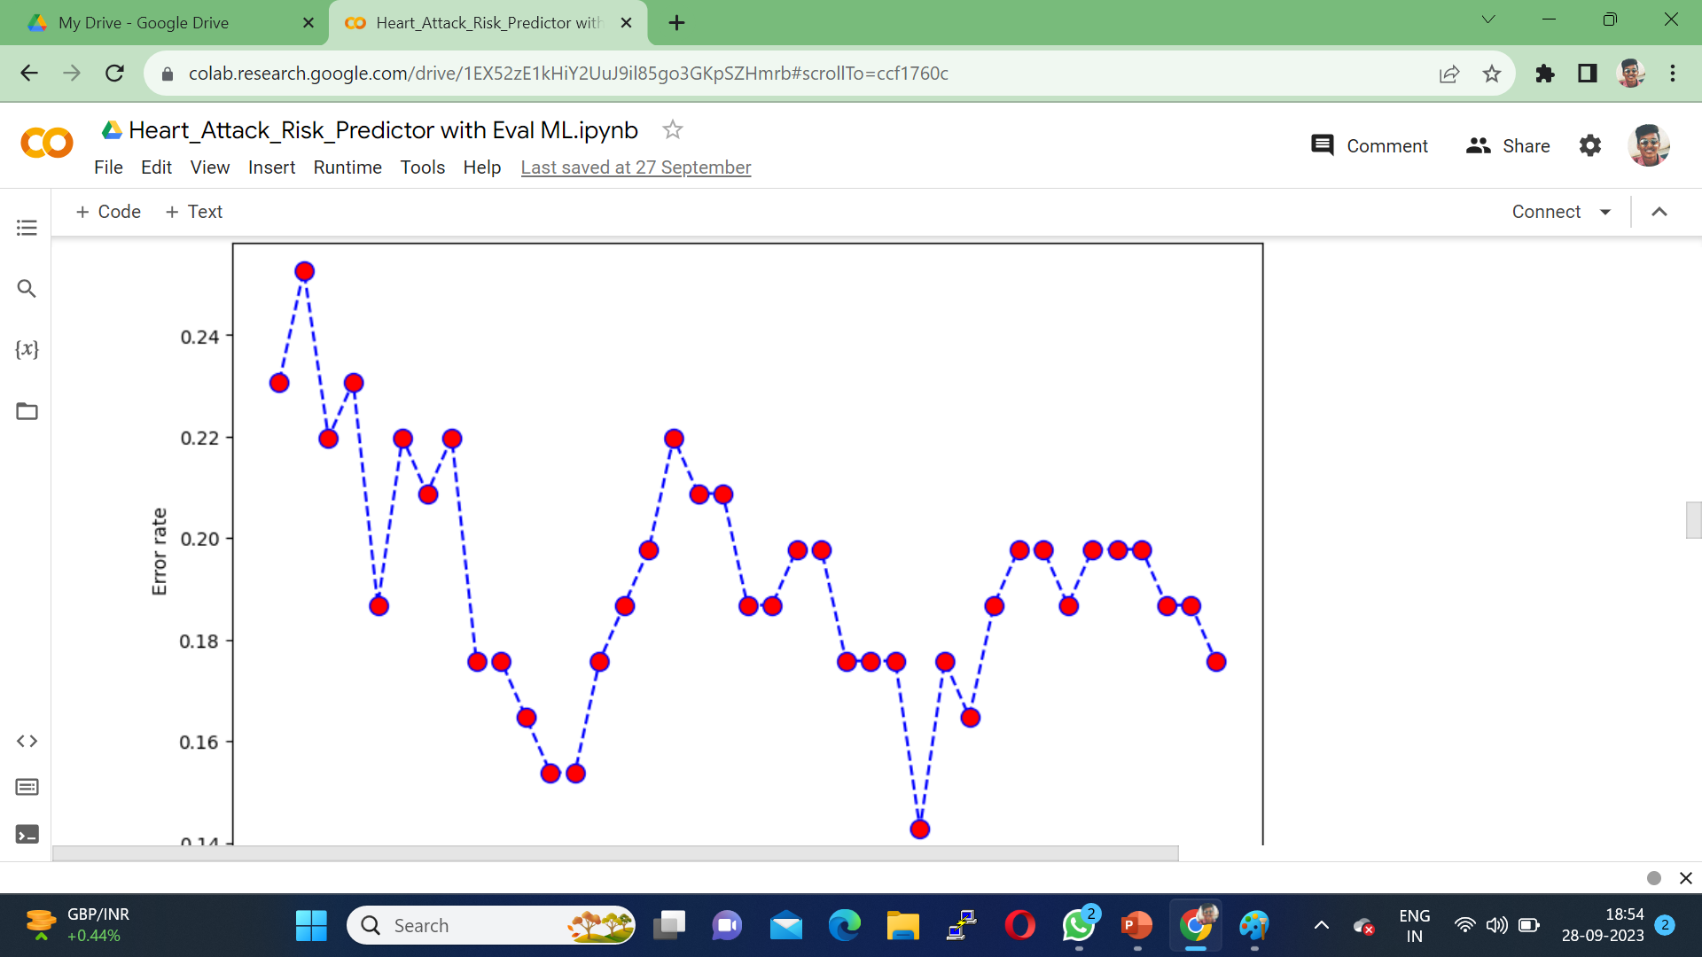
EXPERIMENT SCREENSHORTS

Slide 10
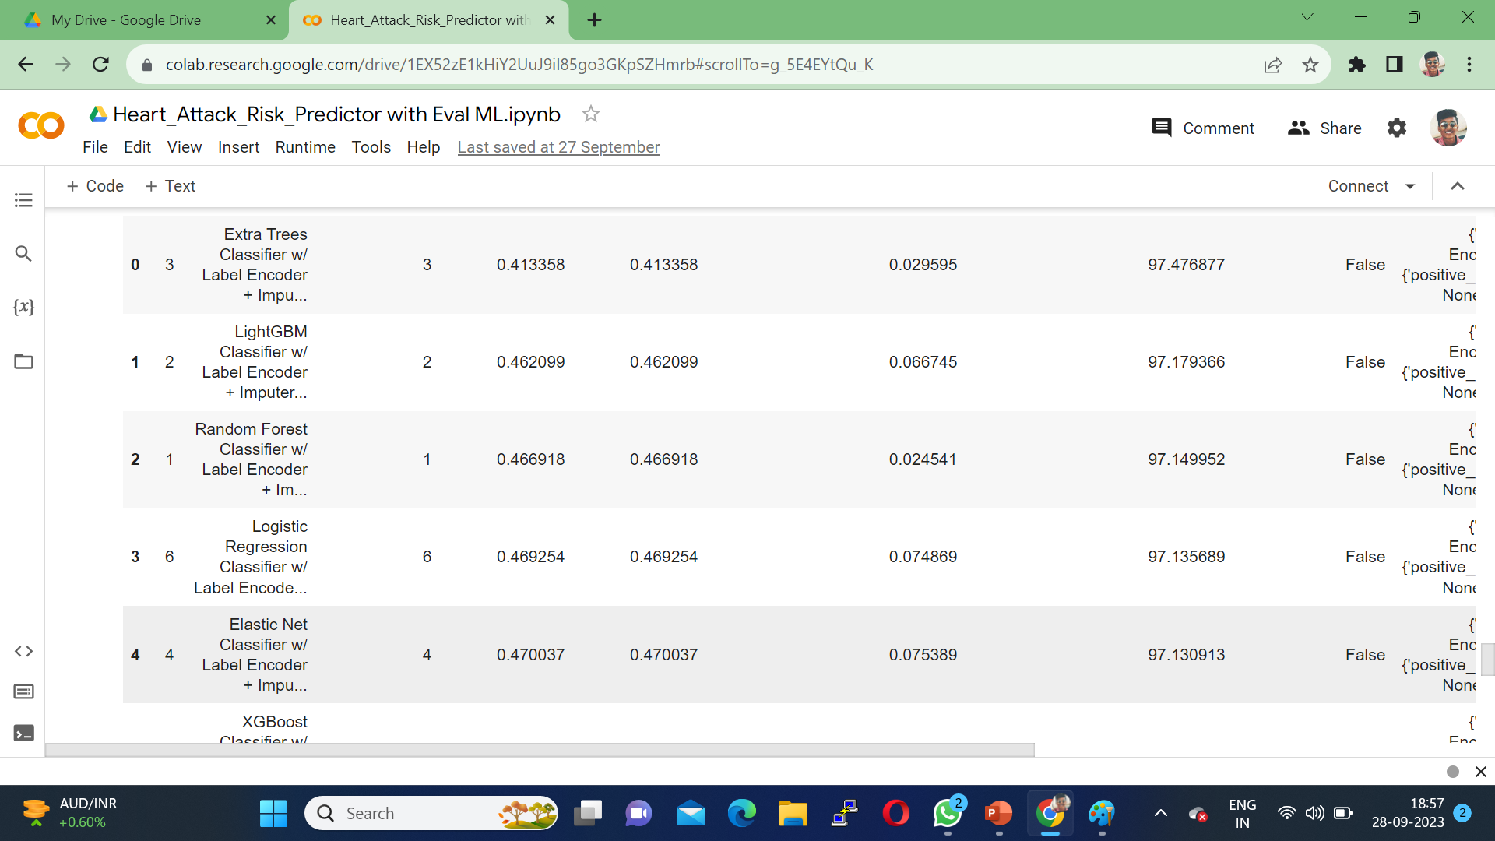
EXPERIMENT RESULTS

Slide 11
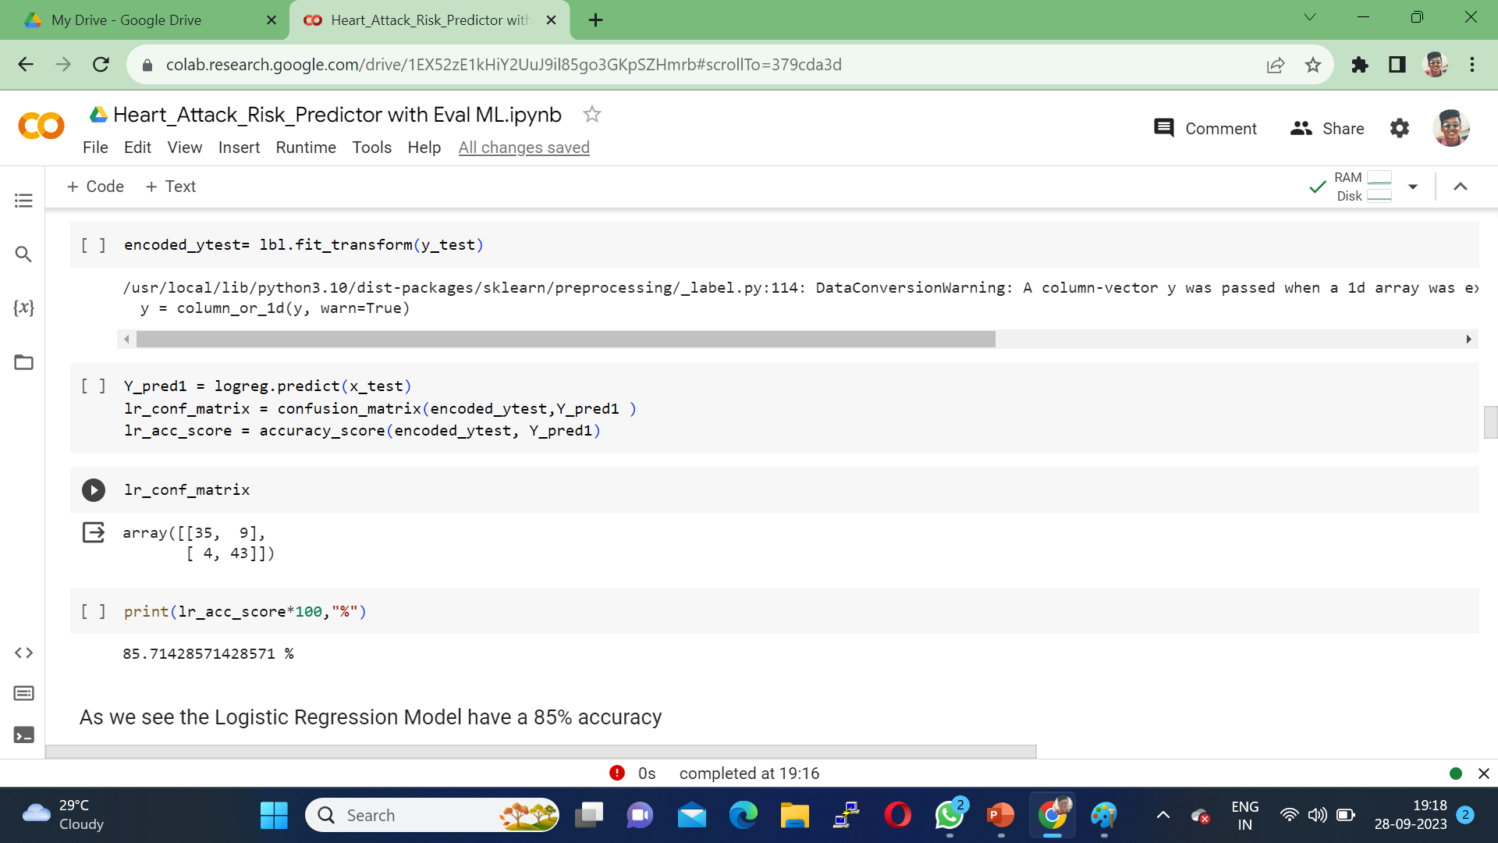
FINDING
While predicting the heart attack risk we are comparing 5 different models which will give best accuracy . In this logistic regression model have best accuracy 85% which is greater than all models knn, svm, decision tree, random forest.

Slide 12
JUSTIFICATION
1.What are parameters improved by your method
accuracy
2.Mathametic formulas for calculating parameter values
Mean score
Standard deviation
Variance
Z-score normalization
3.why your parameter values improved?
Selecting and optimizing best machine learning algorithm
Best dataset
Improves the model performance by fine-tuning parameter

